Slide 1
Indexing-Cont…

Slide 2
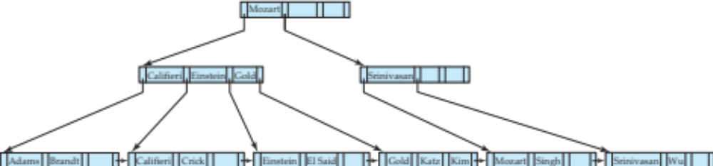
Queries on B⁺-Trees
Select *
From instructor
Where name = ‘Gold’
C = root
While (true)
i = 1
If (false)
Elseif (false)
Else (C = left child)
While (true)
i = 3
If (false)
Elseif (true) C = P₄
While (False)
Return node with ‘Gold’
function find(v)
  1. C=root
  2. while (C is not a leaf node)
    Let i be least number s.t. V ≤ K_{i}.
    if there is no such number i then
    Set C = last non-null pointer in C
    else if (v = C.K_{i} ) Set C = P_{i +1}
    else set C = C.P_{i}
  3. if for some i, K_{i} = V then return C.P_{i}
  4. else return null /* no record with search-key value v exists. */

Slide 3
Queries on B⁺-Trees
Question W-1: Explain how the following queries will be executed using the given B+ tree index.
Select *
from instructor
where name = ‘Crick’
Select *
from instructor
where name = ‘Rafique’
Select *
From instructor
Where name = ‘Gold’
C = root
While (true)
I = 1
If (false)
Elseif (false)
Else (C = left child)
While (true)
I = 3
If (false)
Elseif (true) C = P₄
While (False)
Return node with ‘Gold’
function find(v)
  1. C=root
  2. while (C is not a leaf node)
    Let i be least number s.t. V ≤ K_{i}.
    if there is no such number i then
    Set C = last non-null pointer in C
    else if (v = C.K_{i} ) Set C = P_{i +1}
    else set C = C.P_{i}
  3. if for some i, K_{i} = V then return C.P_{i}
  4. else return null /* no record with search-key value v exists. */

Slide 4
Queries on B⁺-Trees (Cont.)
Range queries find all records with search key values in a given range
Select * from instructor where name < ‘Einstein’
Select * from instructor where name > ‘Einstein’
Use function findRange(lb, ub)

Slide 5
Queries on B⁺-Trees (Cont.)
function findRange(lb, ub)
/* Returns all records with search key value V such that lb ≤ V ≤ ub. */
Set resultSet = {};
Set C = root node
while (C is not a leaf node) begin
Let i = smallest number such that lb ≤ C.Ki
if there is no such number i then begin
Let Pm = last non-null pointer in the node
Set C = C.Pm
end
else if (lb = C.Ki) then Set C = C.Pi+1
else Set C = C.Pi /* lb < C.Ki */
end
/* C is a leaf node */
Let i be the least value such that Ki ≥ lb
if there is no such i
then Set i = 1 + number of keys in C; /* To forcemove to next leaf */
Set done = false;
while (not done) begin
Let n = number of keys in C.
if ( i ≤ n and C.Ki ≤ ub) then begin
Add C.Pi to resultSet
Set i = i + 1
end
else if (i ≤ n and C.Ki > ub)
then Set done = true;
else if (i > n and C.Pn+1 is not null)
then Set C = C.Pn+1, and i = 1 /* Move to next leaf */
else Set done = true; /* No more leaves to the right */
end
return resultSet;

Slide 6
Queries on B⁺⁻Trees (Cont.)
If there are K search-key values in the file, the height of the tree is no more than ⎡log_{⎡n/2⎤}(K)⎤.
A node is generally the same size as a disk block, typically 4 kilobytes
  and n is typically around 100 (40 bytes per index entry).
With 1 million search key values and n = 100
  at most log₅₀(1,000,000) = 4 nodes are accessed in a lookup traversal from root to leaf.
Contrast this with a balanced binary tree with 1 million search key values — around 20 nodes are accessed in a lookup
  above difference is significant since every node access may need a disk I/O, costing around 20 milliseconds

Slide 7
Updates on B⁺-Trees: Insertion
Assume record already added to the file. Let
  pr be pointer to the record, and let
  v be the search key value of the record
Find the leaf node in which the search-key value would appear
  If there is room in the leaf node, insert (v, pr) pair in the leaf node
  Otherwise, split the node (along with the new (v, pr) entry) as discussed in the next slide, and propagate updates to parent nodes.
Construct B+ tree for the search key values 0566,0981, 1350, 1360, 1383, 13120, 1472, 1548, 1651, 1659, 1701, 1702, 1703. The value of n = 5
1. Inserting 0566, 0981, 1350, 1360
 | 0566 |  | 0981 |  | 1350 |  | 1360

Slide 8
Updates on B⁺-Trees: Insertion
Assume record already added to the file. Let
  pr be pointer to the record, and let
  v be the search key value of the record
Find the leaf node in which the search-key value would appear
  If there is room in the leaf node, insert (v, pr) pair in the leaf node
  Otherwise, split the node (along with the new (v, pr) entry) as discussed in the next slide, and propagate updates to parent nodes.
Construct B+ tree for the search key values 0566,0981, 1350, 1360, 1383, 13120, 1472, 1548, 1651, 1659, 1701, 1702, 1703. The value of n = 5
1. Inserting 1383 require splitting of the node (How?)
 | 0566 |  | 0981 |  | 1350 |  | 1360

Slide 9
Updates on B⁺-Trees: Insertion (Cont.)
Splitting a leaf node:
  take the n (search-key value, pointer) pairs (including the one being inserted) in sorted order. Place the first ⎡n/2⎤ in the original node, and the rest in a new node. (Here n = 5, original node = 3, new node = 2 keys
  let the new node be p, and let k be the least key value in p. Insert (k,p) in the parent of the node being split.
  If the parent is full, split it and propagate the split further up.
Construct B+ tree for the search key values 0566,0981, 1350, 1360, 1383, 13120, 1472, 1548, 1651, 1659, 1701, 1702, 1703. The value of n = 5
1. Inserting 1383 require splitting of the node (How?)
 | 1360
 | 0566 |  | 0981 |  | 1350
 | 1360 |  | 1383

Slide 10
Updates on B⁺-Trees: Insertion (Cont.)
Splitting a leaf node:
  take the n (search-key value, pointer) pairs (including the one being inserted) in sorted order. Place the first ⎡n/2⎤ in the original node, and the rest in a new node. (Here n = 5, original node = 3, new node = 2 keys
  let the new node be p, and let k be the least key value in p. Insert (k,p) in the parent of the node being split.
  If the parent is full, split it and propagate the split further up.
Construct B+ tree for the search key values 0566,0981, 1350, 1360, 1383, 1395, 1472, 1548, 1651, 1659, 1701, 1702, 1703. The value of n = 5
Question: Show the B+ tree structure after inserting 1395, 1472, 1548, 1651 into the following tree.
 | 1360
 | 0566 |  | 0981 |  | 1350
 | 1360 |  | 1383

Slide 11
Updates on B⁺-Trees: Insertion (Cont.)
Construct B+ tree for the search key values 0566,0981, 1350, 1360, 1383, 1395, 1472, 1548, 1651, 1659, 1701, 1702, 1703. The value of n = 3
Insert 1472
 | 1350 |  | 1383
 | 0566 |  | 0981
 | 1350 |  | 1360
 | 1383 |  | 1395

Slide 12
Updates on B⁺-Trees: Insertion (Cont.)
Construct B+ tree for the search key values 0566,0981, 1350, 1360, 1383, 1395, 1472, 1548, 1651, 1659, 1701, 1702, 1703. The value of n = 3
 | 1383
 | 1350
 | 1472
 | 0566 |  | 0981
 | 1350 |  | 1360
 | 1383 |  | 1395
 | 1472 |  | 1548

Slide 13
Updates on B⁺-Trees: Insertion (Cont.)
Construct B+ tree for the search key values 0566,0981, 1350, 1360, 1383, 1395, 1472, 1548, 1651, 1659, 1701, 1702, 1703. The value of n = 3
Insert 1701
It requires the reorganization of the internal nodes. Tree height will not be increased.
 | 1383
 | 1350
 | 1472 |  | 1651
 | 0566 |  | 0981
 | 1350 |  | 1360
 | 1383 |  | 1395
 | 1472 |  | 1548
 | 1651 |  | 1659

Slide 14
Updates on B⁺-Trees: Insertion (Cont.)
Construct B+ tree for the search key values 0566,0981, 1350, 1360, 1383, 1395, 1472, 1548, 1651, 1659, 1701, 1702, 1703. The value of n = 3
Insert 1701
It requires the reorganization of the internal nodes. Tree height will not be increased.
 | 1472
 | 1350 |  | 1383
 | 1651 |  | 1701
 | 0566 |  | 0981
 | 1350 |  | 1360
 | 1383 |  | 1395
 | 1472 |  | 1548
 | 1651 |  | 1659
 | 1701 |  | 1702

Slide 15
Updates on B⁺-Trees: Insertion (Cont.)
Splitting a leaf node:
  take the n (search-key value, pointer) pairs (including the one being inserted) in sorted order. Place the first ⎡n/2⎤ in the original node, and the rest in a new node.
  let the new node be p, and let k be the least key value in p. Insert (k,p) in the parent of the node being split.
  If the parent is full, split it and propagate the split further up.
Splitting of nodes proceeds upwards till a node that is not full is found.
  In the worst case the root node may be split increasing the height of the tree by 1.
Result of splitting node containing Brandt, Califieri and Crick on inserting Adams
Next step: insert entry with (Califieri, pointer-to-new-node) into parent

Slide 16
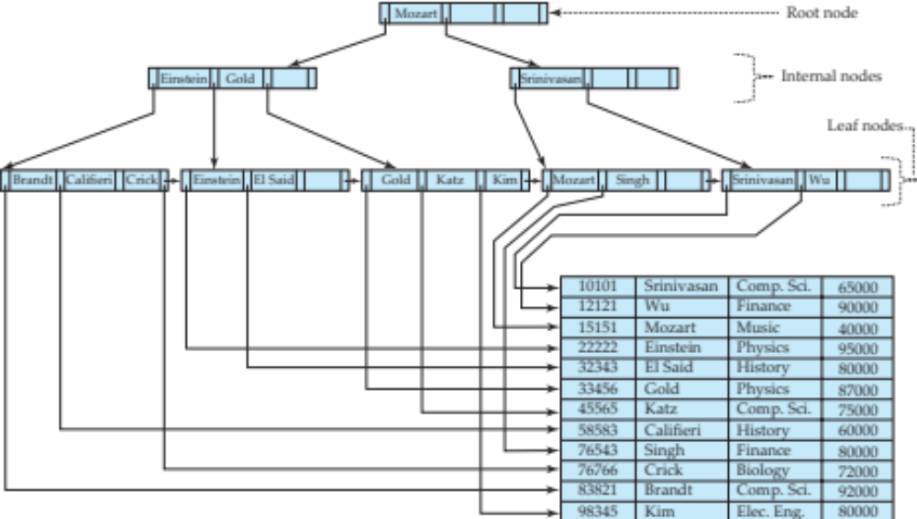
B⁺-Tree Insertion
Affected nodes
B⁺-Tree before and after insertion of “Adams”

Slide 17
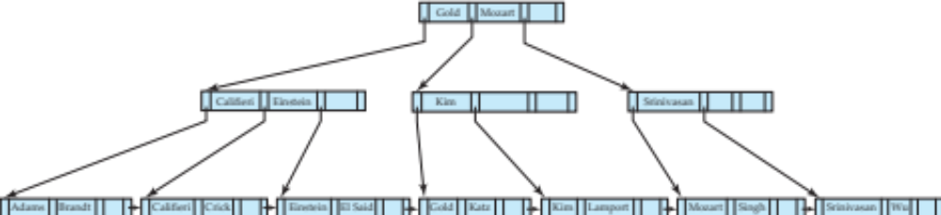
B⁺-Tree Insertion
B⁺-Tree before and after insertion of “Lamport”
Affected nodes
Affected nodes

Slide 18
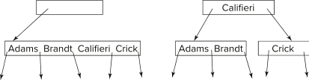
Insertion in B⁺-Trees (Cont.)
Splitting a non-leaf node: when inserting (k,p) into an already full internal node N
  Copy N to an in-memory area M with space for n+1 pointers and n keys
  Insert (k,p) into M
  Copy P₁,K₁, …, K _{⎡n/2⎤-1},P _{⎡n/2⎤} from M back into node N
  Copy P_{⎡n/2⎤+1},K _{⎡n/2⎤+1},…,K_{n},P_{n+1} from M into newly allocated node N'
  Insert (K _{⎡n/2⎤},N') into parent N
Example
Read pseudocode in book!

Slide 19
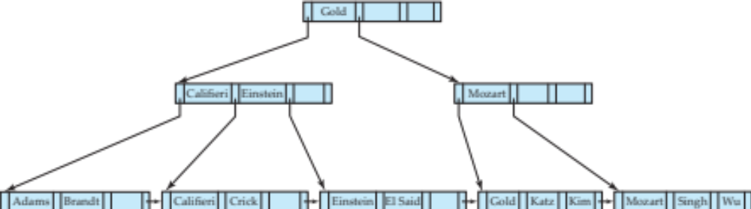
Examples of B⁺-Tree Deletion
Before and after deleting “Srinivasan”
Affected nodes
Deleting “Srinivasan” causes merging of under-full leaves

Slide 20
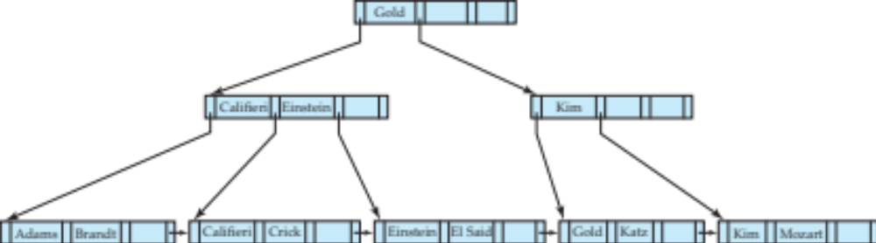
Examples of B⁺-Tree Deletion (Cont.)
Before and after deleting “Singh” and “Wu”
Affected nodes
Leaf containing Singh and Wu became underfull, and borrowed a value Kim from its left sibling
Search-key value in the parent changes as a result

Slide 21
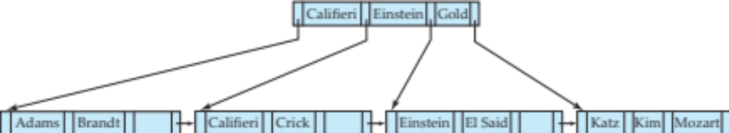
Example of B⁺-tree Deletion (Cont.)
Before and after deletion of “Gold”
Node with Gold and Katz became underfull, and was merged with its sibling
Parent node becomes underfull, and is merged with its sibling
  Value separating two nodes (at the parent) is pulled down when merging
Root node then has only one child, and is deleted

Slide 22
Updates on B⁺-Trees: Deletion
Assume record already deleted from file. Let V be the search key value of the record, and Pr be the pointer to the record.
Remove (Pr, V) from the leaf node
If the node has too few entries due to the removal, and the entries in the node and a sibling fit into a single node, then merge siblings:
  Insert all the search-key values in the two nodes into a single node (the one on the left), and delete the other node.
  Delete the pair (K_{i–1}, P_{i}), where P_{i} is the pointer to the deleted node, from its parent, recursively using the above procedure.

Slide 23
Updates on B⁺-Trees: Deletion
Otherwise, if the node has too few entries due to the removal, but the entries in the node and a sibling do not fit into a single node, then redistribute pointers:
  Redistribute the pointers between the node and a sibling such that both have more than the minimum number of entries.
  Update the corresponding search-key value in the parent of the node.
The node deletions may cascade upwards till a node which has ⎡n/2⎤ or more pointers is found.
If the root node has only one pointer after deletion, it is deleted and the sole child becomes the root.

